Slide 1

Commercial Auto Risk Scoring Case Study
Andrej Šenkery

Slide 2
Agenda
Exploratory Data Analysis (EDA)
Modelling
Production readiness
Summary
Presentation Title

Slide 3

EDA
During EDA I focused on exploring the training and scoring dataset to found any surprising patterns, outliers or missing values

Slide 4
Data types
Ensures Correct Feature Interpretation: Prevents algorithms from misinterpreting data—such as treating date columns as meaningless strings instead of temporal formats
Data Type Cleaning Discoveries:
Converted raw date strings into datetime format to enable downstream feature engineering
Standardized categorical strings by removing trailing whitespaces and fixing inconsistent capitalization to prevent the creation of duplicate, artificial categories
snapshot_date | str
policy_effective_date | str
policy_expiration_date | str
first_claim_reported_date | str

Slide 5
Missing values
General numeric fields were baseline-imputed to 0
risk_score_external column utilized a more granular approach, imputing missing values with conditional group means based on specific Coverage Type and Business Type cohorts to preserve baseline risk variations
Missing values in payment_frequency were explicitly encoded as a distinct 'missing' category
Notes:
Missing values in payment_frequency were explicitly encoded as a distinct 'missing' category, this allows the machine learning algorithm to capture the absence of information as a potentially meaningful risk driver

Slide 6
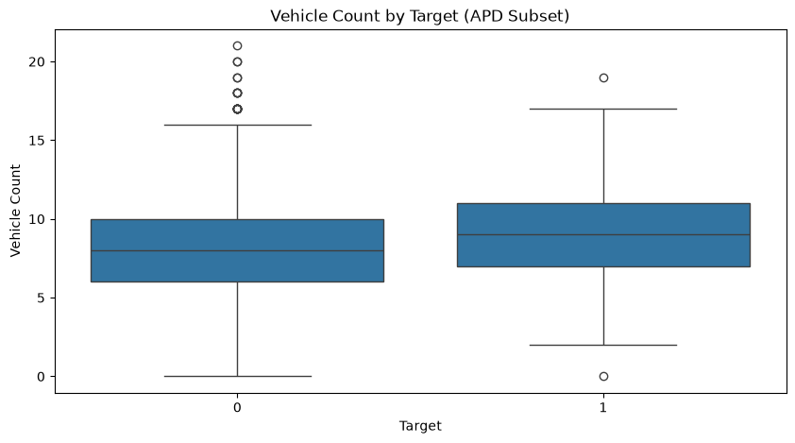
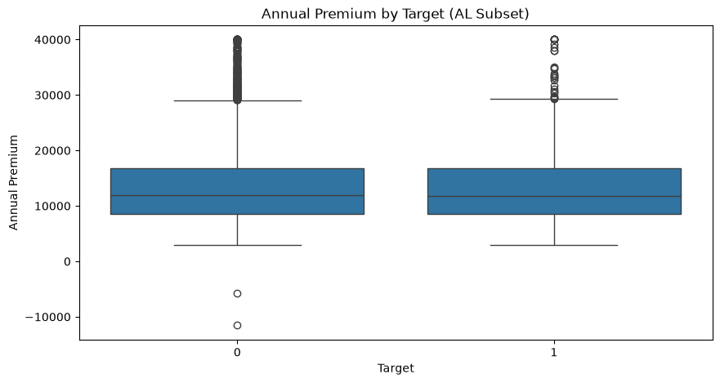
Data split and outliers
Boxplot analysis revealed highly divergent value distributions between Auto Physical Damage (APD) and Auto Liability (AL)
Vehicle count outlier:
For AL it is possible to have business with 0 vehicles
For APD it is not possible
As only 5 rows had vehicle_count = 0, so they were removed
Annual premium:
In a static policy snapshot, negative premiums are anomalies
Notes:
Segmented the dataset into standalone subsets to allow machine learning algorithms to isolate the unique risk drivers inherent to each coverage line.
In commercial insurance, a business can purchase an Auto Liability (AL) policy even if they own zero vehicles. It protects a business if an employee drives their own personal car for work errands (like a delivery driver or salesperson) and gets into an accident. However, a business should never have a vehicle_count = 0 on an Auto Physical Damage (APD) line, because APD strictly insures the physical body of cars owned by the business.
A negative premium is an impossible anomaly in a static risk-scoring snapshot and was removed as there were only 5 of them to preserve model stability.

Slide 7
Mutual Information
Mutual Information (MI) analysis mathematically confirmed that the underlying risk drivers for Auto Liability (AL) and Auto Physical Damage (APD) are fundamentally distinct
In AL some features share no individual predictive information (e.g. years_in_business, driver_avg_age, annual_premium). In APD all features retained a non-zero MI score, demonstrating widespread predictive relevance
total_loss_amount | 0.304397
claim_paid_amount_current_period | 0.304397
days_to_first_claim_report | 0.304330
vehicle_count | 0.008540
num_heavy_vehicles | 0.003795
risk_score_external | 0.003249
prior_year_mileage_000 | 0.002358
prior_al_claim_count | 0.002245
driver_count | 0.001208
prior_apd_claim_count | 0.001109
vehicle_avg_age | 0.000637
late_payment_count | 0.000551
coverage_limit_000 | 0.000380
prior_loss_amount | 0.000099
years_in_business | 0.000000
driver_avg_age | 0.000000
annual_premium | 0.000000
total_loss_amount | 0.433339
claim_paid_amount_current_period | 0.433339
days_to_first_claim_report | 0.433273
vehicle_count | 0.015298
annual_premium | 0.009545
risk_score_external | 0.006360
prior_year_mileage_000 | 0.005316
prior_apd_claim_count | 0.004987
prior_loss_amount | 0.004906
driver_avg_age | 0.002754
num_heavy_vehicles | 0.002381
vehicle_avg_age | 0.002256
years_in_business | 0.001571
late_payment_count | 0.000613
driver_count | 0.000604
prior_al_claim_count | 0.000402
coverage_limit_000 | 0.000137

Slide 8
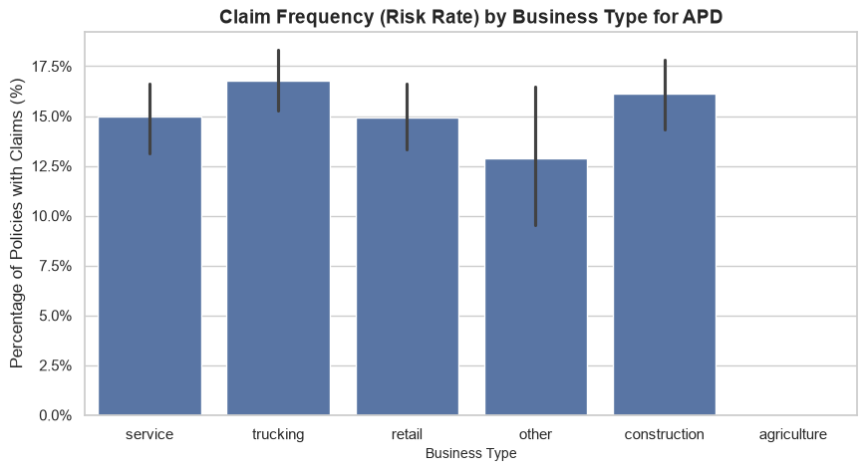
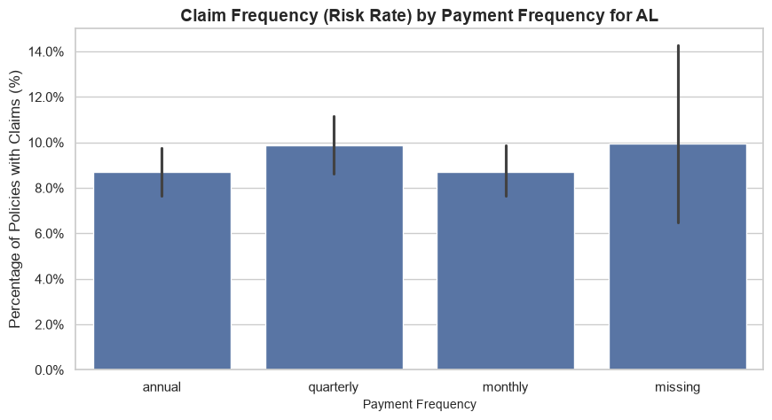
Categorical columns impact
Exploratory analysis revealed significant variance in historical claim frequencies across different categorical levels
This divergence mathematically indicates that these categorical attributes hold strong predictive signals

Slide 9
Omitted features
Following features were omitted:
driver_average_age and annual_premium for AL coverage
claim_status
has_safety_program
claim_paid_amount_current_period and days_to_first_claim_report
Notes:
Reasons
Based on boxplots and Mutual information. Removing them reduces model complexity and eliminates statistical noise. Premium pricing already reflects known risk. Using it as a feature means the model is trying to predict claims using a variable that was created to expect those same claims.
Due to data leakage by providing post-inception claim information. Including it would cause the model to rely on future outcomes, making it useless when evaluating new applicants.
Missing in score dataset
Post-inception metrics known only after claim resolution, because of that we will drop them to prevent look-ahead bias.

Slide 10

Modelling

Slide 11
Improvements for model performance
Split the data into separate Auto Liability (AL) and Auto Physical Damage (APD) subsets to let the algorithms isolate their fundamentally different risk drivers
Omitted business-impossible entries (negative premiums, zero vehicles in APD) and applied conditional cohort-mean imputations to protect baseline risk signals
Dropped retrospective, post-loss operational metrics to ensure the model only uses data available at "time-zero" underwriting
Replaced standard random splitting with a chronological partition (2019–2021 Train / 2022 Test)
Feature standardization
Encoding of categorical columns
Hyperparameter tunning
Notes:
Since the model is Logistic regression standardization is strictly mandatory as it uses regularization
As many features are right-skeewed and contains outliers, we use natural log transformation for prior_loss_amount, annual_premium, prior_year_mileage_000, vehicle_count, driver_count
Then we apply on all numeric columns Robust scaler that uses median and IQR
Used one-hot encoding for business_type and payment_frequency as they have low cardinality and are nominal (you can not order them)
To avoid creating 12 dummy variables for states I decided to use target encoding for states – it replaces values with average value of the target variable for each category

Slide 12
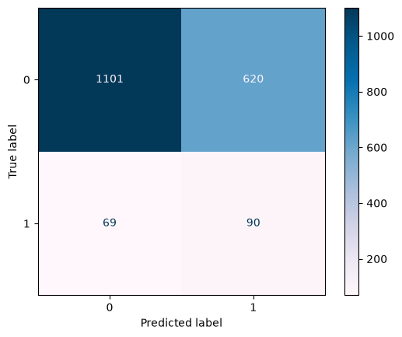
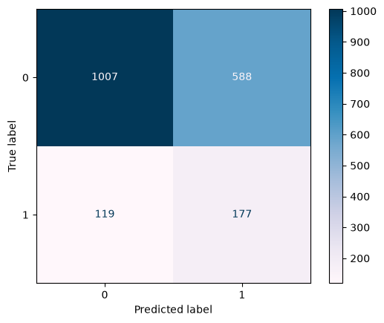
Model results
Class/Metric | precision | recall | f1-score | support
0 | 0.94 | 0.64 | 0.76 | 1721
1 | 0.13 | 0.57 | 0.21 | 159
accuracy |  |  | 0.63 | 1880
macro avg | 0.53 | 0.60 | 0.48 | 1880
weighted avg | 0.87 | 0.63 | 0.71 | 1880
Class/Metric | precision | recall | f1-score | support
0 | 0.89 | 0.63 | 0.74 | 1595
1 | 0.23 | 0.60 | 0.33 | 296
accuracy |  |  | 0.63 | 1891
macro avg | 0.56 | 0.61 | 0.54 | 1891
weighted avg | 0.79 | 0.63 | 0.68 | 1891
Notes:
The severe class imbalance in our dataset reflects the operational reality of commercial auto insurance: claims are low-frequency, high-severity events. This creates a significant challenge for standard classifiers. The confusion matrix shows that the model achieves good overall accuracy simply by defaulting to 'No Claim' predictions. Consequently, the F1-score and recall for our actual target—policies that generate claims—are critically low. To make this model commercially viable, we cannot use hard binary predictions. Instead, we must extract continuous risk probabilities

Slide 13

Production readiness

Slide 14
Production improvements
Splitted data preparation + model training and scoring into 2 separate notebooks
Configured the categorical encoder to cleanly process unseen categories
Consolidated standardization, encoding, hyperparameter optimalization into a unified Scikit-Learn Pipeline to ensure identical data transformations across both training and scoring periods.
Implemented model persistence (saving the trained model artifact) to facilitate instant, low-compute scoring of the 2023–2024 portfolio without re-triggering the training phase
Shifted downstream delivery from rigid binary classes to continuous probability scores
Notes:
To enable independent execution and prevent code redundancy
In a real-world pipeline, data drift happens. The 2023–2024 scoring dataset introduces a new business type (rideshare) that did not exist in the 2020–2022 training data. A naive prototype notebook would instantly crash upon encountering this unseen string.

Slide 15
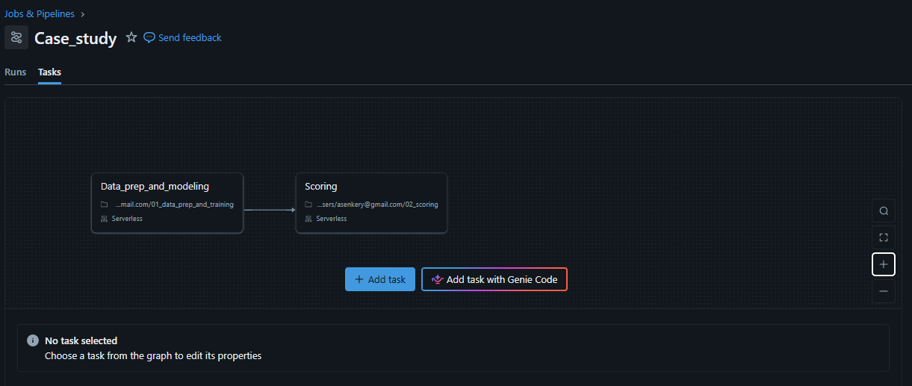
Databricks implementation
Designed simple Job flow in Databricks
Task 1: Executes automated data preparation, isolates coverages (AL vs. APD), trains optimal regularized models, and securely serializes the final model artifacts to storage
Task 2: Automatically triggers only upon the successful completion of Task 1, pulling the frozen model binary to instantly score the unseen 2023–2024 portfolio

Slide 16
Production readiness roadmap
Model validation and governance (before any deployment decision)
Staged deployment
Register approved APD and AL models
Run in shadow mode first: score live policies silently, log predictions, compare against actual outcomes
Define a human-in-the-loop override: underwriters can flag, question, or override a score
Live integration
Ongoing monitoring
Retraining cadence
Define a retraining trigger: time-based (e.g., annual, aligned to policy year) and/or performance-based
Notes:
1. Model validation & governance (before any deployment decision)
Actuarial review of probability scores and their mapping to premium risk-loadings, within applicable state rate-filing constraints
Regulatory/fairness review: test target-encoded state and business_type (and other categoricals) for proxy discrimination against protected characteristics; document non-discrimination justification per state insurance department requirements
Produce a model card / documentation package: feature list, training population and date range, known limitations (e.g., zero-MI features excluded, rideshare underrepresented in training), performance by segment (APD vs. AL, by state, by business type)
3. Live integration
Connect the API to the core underwriting portal so a broker entering a new fleet's attributes receives a live risk score within seconds
4. Ongoing monitoring (post-launch, continuous)
Operational dashboards: inference latency, server errors, uptime
Calibration monitoring: track predicted-vs-actual claim rates over time to detect drift in probability accuracy, not just prediction stability

Slide 17

Summary

Slide 18
New concepts learned
Insurance data specifics
Scikit-learn pipeline building and implementation
New approach to standardization (Robust scaler)
New approach to encoding (Target encoding)
Preserving trained model
ML model lifecycle

Slide 19
AI tools used
GitHub Copilot for code suggestion
Gemini and Claude for reseach of ideas, approaches and for text polishing and rewriting
Gemini for code debugging and code assistance

Slide 20



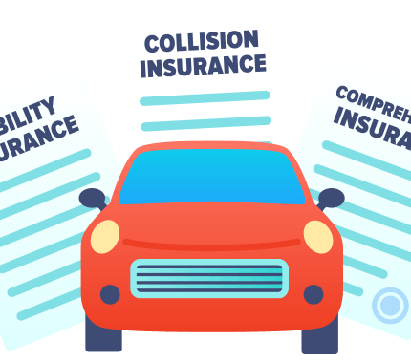
Thank you for your attention

